Slide 1
Document Object Model
The DOM is an in-memory representation of a web page
It's a tree of objects the browser creates from interpreting the html
each element becomes an Element node
each piece of text becomes a Text node
attributes become Attribute nodes
the whole thing becomes a Document object
The tree is what JavaScript manipulates, not the raw HTML

Slide 2
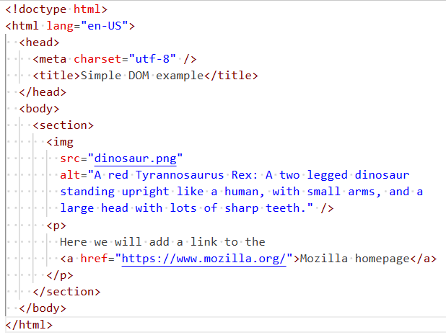
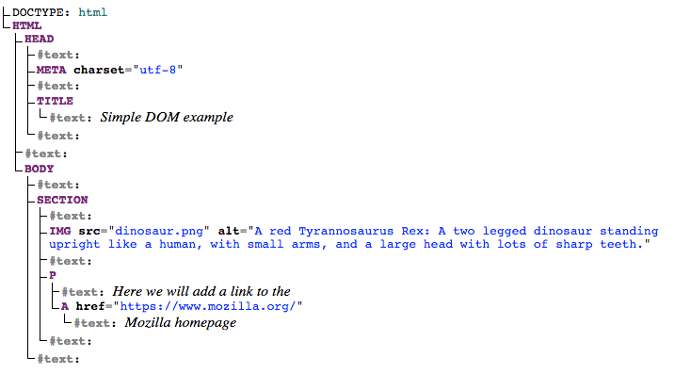
HTML
DOM
Notes:
Blank text is used to indicate white space

Slide 3
JavaScript interaction with HTML
JavaScript can be used for front-end and backend programming; we'll start with the front-end
JavaScript is event driven so you write functions that respond to events. For example, the onclick event of a button press triggers an event handler in JavaScript
To create a button in html, you can use: <button type="button" onclick="functionName()">Press me</button>. When clicked, this will call the named function in the JavaScript file you have linked to your html. The text on the button in this case is “Press me”
You will see this in examples but it's considered bad practice as you tightly couple the html and JS. The preferred approach is to register an event handler to respond to events generated by html controls such as onClick, mouseover etc. All controls will generate all sorts of events
IDs in HTML are used to identify elements on the page you want JavaScript to interact with. A key JavaScript Function is document.getElementById(“element”) which returns the named html element so you can interact with it and change its properties
For example, if you have a paragraph of text with an id of “para” or whatever, you can read the content of the paragraph into a JavaScript variable using the .innerText function
JavaScript can also be used to add html to the page using .innerHTML
demos/html/html-js1.html
Notes:
HTML renders content
CSS styles the content
JavaScript makes the content interactive
So keep in separate files - separation of concerns

Slide 4
Generating html
When a web page is requested from a server, it's likely that the server needs to create that page, especially if it contains up to date data read from a database
You may for example, change your order from one to two items and the price is updated. Using the "old" approach, the server would need to modify the web page and send you the whole page with the updated price. If there are thousands of users, this is a load on the server and requires the bandwidth to send all the html for the page
This approach can still be used but another approach is for the browser to request only the data then modify the page at the front end. The compute load is moved to the client and the bandwidth is reduced
We will emulate data returned from a server it has retrieved from a database and create the output
We can pretend we have asked for a price list from the web server, it has pulled the data from the database and just sent the data to us - not a web page containing the data
We will display the pricelist in a table
/demos/html/priceList.html
Notes:
Exercise: /labs/4html_css_js
Use as a starter for research then review the concepts again

Slide 5
Asynchronicity in JavaScript
Notes:
Time to place a wet towel over your head …

Slide 6
Learning objectives
Upon successfully completing this section, you will be able to:
Explain the difference between synchronous and asynchronous operations
Explain how JavaScript handles asynchronous operations
Explain the purpose and operation of JavaScript callbacks and promises
Use promises in your code for asynchronous operations
Explain the concept of middleware and use it in your solutions
Explain and use same origin requests
Create a front-end that displays API data retrieved from your application and web server

Slide 7
A bit more JavaScript
Chaining and exceptions using demos
Chaining enables an object to call a method which returns an object which can then call a method
Exceptions are used to simplify error conditions especially when the error occurs deep within multiple function calls
An exception can throw the code sequence out of a try block and into a catch block where the issue can be dealt with. There is however, no way back to the sequence of code where the exception occurred
try { do something do something else if do something didn't error so throw an exception }
catch (exception obj) { output a message or try to recover from the error somehow but no way back }
finally { optionally execute in either case. Used to clean up such as closing files. }
demos/async/chaining.js
demos/async/except1.js

Slide 8
Sync and Async
Synchronous operations are those which take place sequentially. For example, you get to the head of the queue at a sandwich bar at a train station. You place your order for a toastie with the assistant. They go off and do their thing and make the sandwich – maybe chatting to someone or staring into space whilst the sandwich is toasting. Eventually they come back to you and ask “Is there anything else?” You order a coffee. They go off and do their thing – maybe stare into space whilst the milk boils then returns with your coffees. “Anything else?” By now you are getting disapproving looks from others in the queue so say no. You are asked for payment. You pay cash so they go off to the till and cash the money but they don’t have change so have to go into the office to get some change. They eventually complete the payment and you can be on your way whilst half of the queue have given up and gone for their train. Synchronous operations are simple but block execution whilst waiting
Ok, you could employ 3 people with 3 tills and 3 toasters etc. This is clearly more efficient but also more expensive. This is parallel processing and now has 3 people (CPUs) staring into space at various times.
A different approach could be to employ an asynchronous process. An attendant takes your order but whilst the sandwich is in the toaster, they take your next order – maybe that’s for coffee, but if not they can take an order from the next person. So whilst the toaster is still toasting and the milk is still boiling, they can take another order. At some point, the milk is boiling – maybe the toaster is still toasting. The assistant can stop taking orders and finish the coffee – which started after the toaster so is out of order. During finishing the coffee, the toaster finishes so once the coffee order is complete, they can go to the toaster and finish the toastie order. The key point here is that a long process can be kicked-off but this doesn’t block the assistant. They can do other things whilst waiting. This is more efficient but more complex as the orders may be completed out of order and the person needs to remember which order is for whom. Java uses multithreading for parallelism, JavaScript is single threaded so relies on asynchronous function calls to avoid blocking the single application thread

Slide 9
Calling an API from the frontend
Response from the app server may be slow so waiting for a response will block the single thread
The UI becomes unresponsive whilst waiting - this is synchronous
A JavaScript function, fetch, will make the API call but asynchronously
The call is made but we don't wait for the response
The UI remains responsive whilst fetch is waiting for a response in the background
effectively running in a separate thread (discussed later)
We also need to consider not blocking the server thread if it needs to do something lengthy
e.g. search for data in a database. Make this server call asynchronous too
When the response is received from the app server, it is somehow dealt with in the main thread
A couple of quick examples to illustrate this so you can do your practical exercise
Detail of how it all works follows
demos/API/basic
demos/api/simpleAPIstatic

Slide 10


Origins and Cross Origin Resource Sharing (CORS)
We work with same origin or cross origin
Origin is scheme://domain:port
e.g. http://tonynicol.com:3000 or http://20.234.12.254:3000
Same origin
The user makes a request to say http://20.234.12.254:3000/jokes.html
express.static will return the web page
the page requests css with href="jokes.css". No need for origin as browser will assume same origin and add the http://20.234.12.254:3000/jokes.css
page requests javascript with src="jokes.js" using same assumption
With page displayed and formatted, press a button to invoke fetch()
fetch will also assume same origin so we only need fetch('/jokes/general')
You can write fetch('http://20.234.12.254:3000/jokes/general') if you want to
As long as the origin is the same as the web page it's fine
fetch() from a different origin is a security issue and is blocked by default
page may be infected to point to a different origin to send information from your page
Node app server & express static
Database server
MySql
20.234.12.254

Slide 11
Cross origin
When we develop APIs, we don't usually provide a front-end
APIs are for use by many different users to get or change data
They provide their own web front-end
The front-end files are requested from their own web server - API call is cross origin
API call is to a different (cross) origin. Blocked by default. Server needs to enable CORS policy
Server CORS Policy can include list of origins, http method and various other conditions
http://20.234.12.254:3000/jokes/dad
http://20.234.12.254:3000/jokes/programming?count=20
http://30.14.120.42/index.html
http://230.144.12.4/index.html
Nginx
web server
Node app server (API)
Apache HTTP server
30.14.120.42
230.144.12.4
Database server
Company app with
Joke of the day
Google cloud
Christmas cracker
print app
AWS
MySql
20.234.12.254
Joke server Azure

Slide 12
Cross origin
A better approach is for the communication to go from server to server
Use https and send a pre-agreed bearer token such as an API key in a JWT or Oauth token for authorisation
As the browser is not involved, there is no CORS issue or risk
http://230.144.12.4/index.html
http://30.14.120.42/index.html
https://20.234.12.254:3000/jokes/dad
http://20.234.12.254:3000/jokes/programming?count=20
Authorization: Bearer <secret>
Node app server (API)
Authorization: Bearer <secret>
Nginx
web server
Apache HTTP server
Database server
30.14.120.42
230.144.12.4
MySql
Company app with
Joke of the day
Google cloud
Christmas cracker
print app
AWS
20.234.12.254
Joke server Azure
Notes:
Secret could be an API key in a jwt or an openid connect jwt or whatever

Slide 13
JavaScript Message Handling
Due to the single thread, executing a lengthy function will freeze the UI
To avoid this, we can use asynchronous functions to sort of multi-thread
The asynchronous function is suspended so the main thread can continue
The asynchronous functionality in the background runs in C on threads within C, not JavaScript
Once complete, the asynchronous function adds a callback to the event queue
We need a diagram for this …

Slide 14
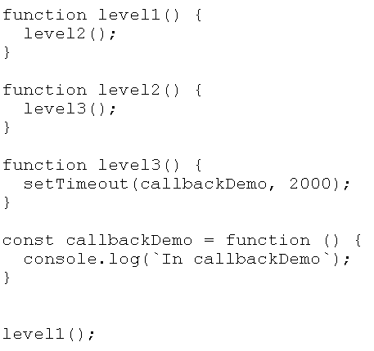
Call Stack (LIFO)
APIs
CheckboxClick
callbackDemo
ButtonClick
Fetch
AudioData
console
crypto
+ hundreds more
Message Handler
Event queue (FIFO)
ButtonClick
CheckboxClick
callbackDemo

Slide 15
Asynchronous approaches
We've seen how callback functions like setTimeout work in JavaScript to make an async call
But, multiple callbacks within callbacks can get quite complex, especially in error conditions, so the concept of a promise, was added to the language. Callbacks are still used
A further addition to the language is async and await. These further simplify the coding of asynchronous operations using promises
Callback, promise and async / await are a little tricky to get your head around at first and are areas that interviewers often ask about to differentiate basic JavaScript programmers from those with an understanding of asynchronous operations handled by these JavaScript language features
To reiterate: a callback is a function which is passed to another function as an argument. The function "registers" the callback. i.e. it notes the function's execution address. If the function is asynchronous, when the main function, e.g. fetch or setTimeout, is ready, e.g., reading data from a file or database or whatever it is that's likely to take time, it will pass the registered callback function to the event queue to be executed when the thread is available. Using a promise is just a syntactically better way of achieving the same result
If the callback is not asynchronous, when the parent function is ready, it will execute the callback synchronously

Slide 16
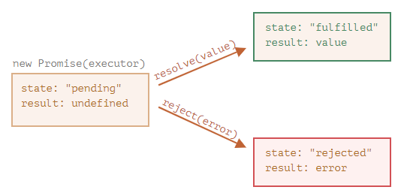
Promises
A promise is called that because it is a promise, agreed now, but to do something later. A promise is an object with two key properties: state and result. It has three states: pending, fulfilled or rejected. Whilst it waits for an asynchronous event to complete, it has a status of “pending”. This is just a newer way of implementing asynchronous operations instead of callbacks
We can create promise-based code and we use promise-based code from others
Notes:
Graphical sequence of promise 1 on next slide
The promise methods are documented here: https://developer.mozilla.org/en-US/docs/Web/JavaScript/Reference/Global_Objects/Promise

Slide 17
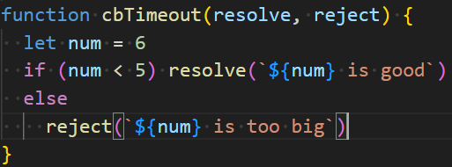
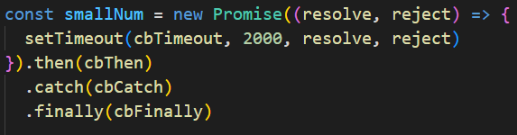




Written using full functions to illustrate sequence
Typically use arrow functions
Typically create promise in a function
demos/async/promise1.js
demos/async/promise1b.js

